Slide 1
Movies Dashboard Analysis
Data Visualization & Insights Using Power BI
Presented by:
SADHANA RAJAK
Tools Used:
Power BI | Data Visualization | Dashboard Analysis

Slide 2
Project Objective
The objective of this project is to analyze movie ratings, genres, and trends using Power BI dashboards to identify audience preferences and generate meaningful business insights through data visualization.

Slide 3
Dataset Overview
The dataset contains movie-related information including:
- Movie Titles
- Genres
- Ratings
- Release Years
- User Reviews
- Rating Distribution
- Genre Performance
The project was developed using Power BI visualization and dashboard techniques.
TOOLS USED:
Power BI
Data Visualization
Dashboard Design
Data Analysis
Basic Statistical Validation

Slide 4
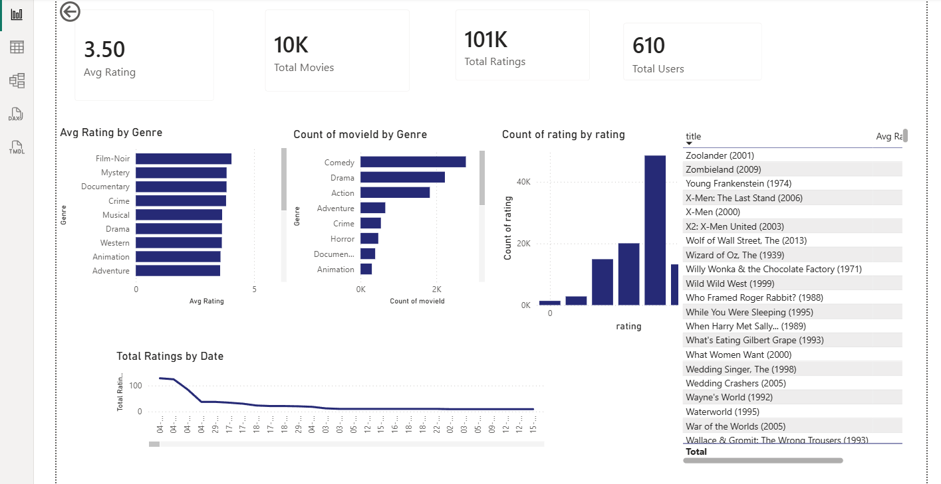
Dashboard Overview
The dashboard visually represents movie ratings, genre distribution, and audience preferences through interactive charts and KPI analysis.

Slide 5
Analysis Performed
The following analysis was performed:
Average Rating Analysis
Genre-wise Movie Distribution
Ratings Trend Analysis
Audience Preference Analysis
High Rated Genre Identification
Rating Frequency Distribution
Movie Performance Comparison

Slide 6
Key Business Insights
Comedy genre contained the highest number of movies.
Film-Noir and Mystery genres showed higher average ratings.
Most movies received ratings within the medium to high range.
Audience preferences varied across genres.
Certain genres consistently performed better in user ratings.

Slide 7
Statistical Validation
Null Hypothesis (H₀):
Average movie ratings are equal across all genres.
Alternative Hypothesis (H₁):
Some movie genres have significantly different average ratings.
A basic statistical comparison was performed to evaluate rating differences across genres. The findings suggest that audience ratings vary between genres, indicating different levels of audience preference.
p<0.05
Values below 0.05 are considered statistically significant.

Slide 8
Business Recommendations
Focus content production on highly rated genres.
Improve recommendation systems based on audience preferences.
Promote genres with strong audience engagement.
Use rating trends to support future content strategy decisions.
Analyze user feedback to improve audience satisfaction.

Slide 9
Conclusion
This project successfully transformed movie rating data into meaningful audience insights using Power BI dashboard visualization techniques.
The analysis supports better decision-making related to content strategy, audience engagement, and genre performance evaluation.

